Slide 1
Data Mining Unit-II: Association Analysis
Dr.G.Padmavathi Associate professor CRRAO AIMSCS

Slide 2
Course Overview
Credits: 3 (L-T-P: 3-0-0)
Pre-requisites: Database Management Systems
Probability and Statistics
Goal: Introduce key data mining techniques & their applications

Slide 3
Data Mining Syllabus
UNIT - I
Introduction to Data Mining:
What Data mining? Kinds of Data, Knowledge Discovery process, Data Mining Functionalities, Kinds of Patterns, Major Issues in Data Mining. Data Objects and Attribute Types, Basic Statistical Descriptions of Data, Data Visualization, Measuring Data Similarity and Dissimilarity, Data Pre-processing: Major Tasks in Data Pre-processing, Data Cleaning, Data Integration, Data Reduction, Data Transformation and Data Discretization.
UNIT - II
Association Analysis: Basic Concepts, Market Basket Analysis, Apriori Algorithm, FP-growth, From Association Analysis to Correlation Analysis, Pattern Mining in Multilevel Associations and Multidimensional Associations.
UNIT - III
Classification: Basic Concepts, Decision Tree Induction, Bayes Classification Methods, Rule-Based Classification, Metrics for Evaluating Classifier Performance, Ensemble Methods, Multilayer Feed- Forward Neural Network, Support Vector Machines, k-Nearest-Neighbor Classifiers.
UNIT - IV
Cluster Analysis: Requirements for Cluster Analysis, Overview of Basic Clustering Methods, Partitioning Methods-k-Means, k-Medoids, Hierarchical Methods-AGENES, DIANA, BIRCH, Density- Based Method-DBSCAN, Outlier Analysis: Types of Outliers, Challenges of Outlier Detection, and Overview of Outlier Detection Methods
UNIT - V
Advanced Concepts: Web Mining- Web Content Mining, Web Structure Mining, Web Usage Mining, Spatial Mining- Spatial Data Overview, Spatial Data Mining Primitives, Spatial Rules, Spatial Classification Algorithm, Spatial Clustering Algorithms, Temporal Mining- Modeling Temporal Events, Time Series, Pattern Detection, Sequences, Temporal Association Rules.

Slide 4
TEXT BOOKS:
Jiawei Han, Micheline Kamber, Jian Pei., Data Mining: Concepts and Techniques, 3rd Edition, Morgan Kaufmann/Elsevier, 2012.
Margaret H Dunham, Data Mining Introductory and Advanced Topics, 2nd Edition, Pearson Education, India, 2006.
REFERENCE BOOKS:
Data Mining Techniques, Arun K Pujari, 3rd Edition, Universities Press.
Pang-Ning Tan, Michael Steinbach, Anuj Karpatne and Vipin Kumar, Introduction to Data Mining, 2nd Edition, Pearson Education India, 2021.
Amitesh Sinha, Data Warehousing, Thomson Learning, India, 2007.

Slide 5
UNIT – III Classification
Classification: Basic Concepts
Bayes Classification Methods
Decision Tree Induction
Rule-Based Classification
Metrics for Evaluating Classifier Performance
Ensemble Methods
Multilayer Feed- Forward Neural Network
Support Vector Machines
k-Nearest-Neighbor Classifiers

Slide 6
Bayesian Classification: Why?
A statistical classifier: performs probabilistic prediction, i.e., predicts class membership probabilities
Foundation: Based on Bayes’ Theorem.
Performance: A simple Bayesian classifier, naïve Bayesian classifier, has comparable performance with decision tree and selected neural network classifiers
Incremental: Each training example can incrementally increase/decrease the probability that a hypothesis is correct — prior knowledge can be combined with observed data
Standard: Even when Bayesian methods are computationally intractable, they can provide a standard of optimal decision making against which other methods can be measured

Slide 7
Bayes’ Theorem: Basics
Total probability Theorem:
Bayes’ Theorem:
Let X be a data sample (“evidence”): class label is unknown
Let H be a hypothesis that X belongs to class C
Classification is to determine P(H|X), (i.e., posteriori probability): the probability that the hypothesis holds given the observed data sample X
P(H) (prior probability): the initial probability
E.g., X will buy computer, regardless of age, income, …
P(X): probability that sample data is observed
P(X|H) (likelihood): the probability of observing the sample X, given that the hypothesis holds
E.g., Given that X will buy computer, the prob. that X is 31..40, medium income

Slide 8
Bayes Theorem

Slide 9
Companies B1, B2, B3 produce 30%, 45% and 25% of the cars respectively. If it is known that 2%, 3% and 2% of the cars produced from B1, B2 and B3 are defective. If a car purchased is found to be defective. What is the probability that their car is produced by company B1, B2 and B3?

Slide 10
Companies B1, B2, B3 produce 30%, 45% and 25% of the cars respectively. If it is known that 2%, 3% and 2% of the cars produced from B1, B2 and B3 are defective. If a car purchased is found to be defective. What is the probability that their car is produced by company B1, B2 and B3?
 | P(Bi),i=1,2,3 | P(D/Bi) | P(Bi) P(D/Bi)
B1 | 0.3 | 0.02 | 0.006 | 0.2449
B2 | 0.45 | 0.03 | 0.0135 | 0.55102
B3 | 0.25 | 0.02 | 0.005 | 0.20408
 |  |  | 0.0245 | 1

Slide 11
Bayes Theorem Problem
Problem 1: Let’s work on a simple NLP problem with Bayes Theorem. By using NLP, I can detect spam e-mails in my inbox. Assume that the word ‘offer’ occurs in 80% of the spam messages in my account. Also, let’s assume ‘offer’ occurs in 10% of my desired e-mails. If 30% of the received e-mails are considered as a spam, and I will receive a new message which contains ‘offer’, what is the probability that it is spam?

Slide 12
Bayes Theorem Problem
Problem 1:
Let’s work on a simple NLP problem with Bayes Theorem. By using NLP, I can detect spam e-mails in my inbox. Assume that the word ‘offer’ occurs in 80% of the spam messages in my account. Also, let’s assume ‘offer’ occurs in 10% of my desired e-mails. If 30% of the received e-mails are considered as a scam, and I will receive a new message which contains ‘offer’, what is the probability that it is spam?
Now, I assume that I received 100 e-mails. The percentage of spam in the whole e-mail is 30%. So, I have 30 spam e-mails and 70 desired e-mails in 100 e-mails. The percentage of the word ‘offer’ that occurs in spam e-mails is 80%. It means 80% of 30 e-mail and it makes 24.
Now, I know that 30 e-mails of 100 are spam and 24 of them contain ‘offer’ where 6 of them not contains ‘offer’.
The percentage of the word ‘offer’ that occurs in the desired e-mails is 10%. It means 7 of them (10% of 70 desired e-mails) contain the word ‘offer’ and 63 of them not.Now, we can see this logic in a simple chart.

Slide 13
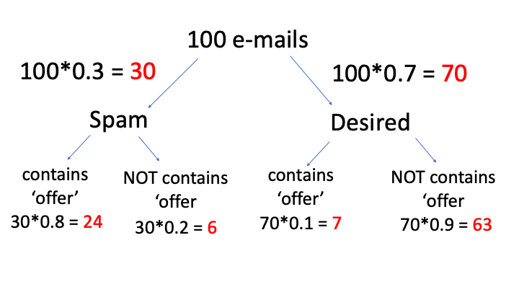
Bayes Theorem Problem
Problem 1:
Let’s work on a simple NLP problem with Bayes Theorem. By using NLP, I can detect spam e-mails in my inbox. Assume that the word ‘offer’ occurs in 80% of the spam messages in my account. Also, let’s assume ‘offer’ occurs in 10% of my desired e-mails. If 30% of the received e-mails are considered as a scam, and I will receive a new message which contains ‘offer’, what is the probability that it is spam?

Slide 14
Spam-A1 Desired-A2 | Offer-O P(O/Ai) | P(Ai)*P(O/Ai) | [P(Ai)*P(O/Ai)]/P(O)
P(A1)=0.3 | P(O/A1)=0.8 | (0.3)(0.8)=0.24 | 0.24/0.31=0.7741
P(A2)=0.7 | P(O/A2)=0.1 | (0.7)(0.1)=0.07 | 0.07/0.31=0.225
Total |  | P(O)=0.31

Slide 15
As you know, Covid-19 tests are common nowadays, but some results of tests are not true. Let’s assume; a diagnostic test has 99% accuracy and 60% of all people have Covid-19. If a patient tests positive, what is the probability that they actually have the disease?

Slide 16
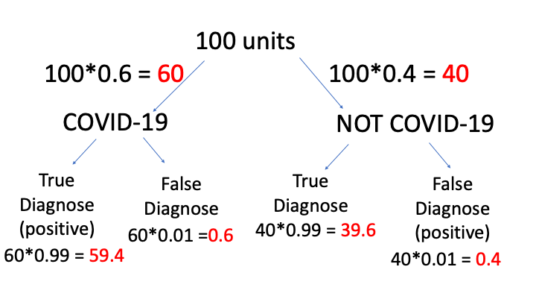
As you know, Covid-19 tests are common nowadays, but some results of tests are not true. Let’s assume; a diagnostic test has 99% accuracy and 60% of all people have Covid-19. If a patient tests positive, what is the probability that they actually have the disease?

Slide 17
Covid-A1 Not Covid-A2 | Positive -P | P(Ai)*P(O/Ai) | [P(Ai)*P(O/Ai)]/P(O)
P(A1)=0.6 | P(P/A1)=0.99 | (0.6)(0.99)=0.594 | 0.594/0.598=0.993
P(A2)=0.4 | P(P/A2)=0.01 | (0.4)(0.01)=0.004 | 0.004/0.598=0.00668
Total |  | P(O)=0.598 | 0.99968

Slide 18
Prediction Based on Bayes’ Theorem
Given training data X, posteriori probability of a hypothesis H, P(H|X), follows the Bayes’ theorem
Informally, this can be viewed as
posteriori = likelihood x prior/evidence
Predicts X belongs to C_{i} iff the probability P(C_{i}|X) is the highest among all the P(C_{k}|X) for all the k classes
Practical difficulty: It requires initial knowledge of many probabilities, involving significant computational cost

Slide 19
Classification Is to Derive the Maximum Posteriori
Let D be a training set of tuples and their associated class labels, and each tuple is represented by an n-D attribute vector X = (x₁, x₂, …, x_{n})
Suppose there are m classes C₁, C₂, …, C_{m}.
Classification is to derive the maximum posteriori, i.e., the maximal P(C_{i}|X)
This can be derived from Bayes’ theorem
Since P(X) is constant for all classes, only
needs to be maximized

Slide 20
Naïve Bayes Classifier
A simplified assumption: attributes are conditionally independent (i.e., no dependence relation between attributes):
This greatly reduces the computation cost: Only counts the class distribution
If A_{k} is categorical, P(x_{k}|C_{i}) is the # of tuples in C_{i} having value x_{k} for A_{k} divided by |C_{i, D}| (# of tuples of C_{i} in D)
If A_{k} is continous-valued, P(x_{k}|C_{i}) is usually computed based on Gaussian distribution with a mean μ and standard deviation σ
and P(x_{k}|C_{i}) is

Slide 22
Naïve Bayes Classifier: Training Dataset
Class:
C1:buys_computer = ‘yes’
C2:buys_computer = ‘no’
Data to be classified:
X = (age <=30,
Income = medium,
Student = yes
Credit_rating = Fair)

Slide 23
Naïve Bayes Classifier: An Example
P(C_{i}): P(buys_computer = “yes”) = 9/14 = 0.643
P(buys_computer = “no”) = 5/14= 0.357
Compute P(X|C_{i}) for each class
P(age = “<=30” | buys_computer = “yes”) = 2/9 = 0.222
P(age = “<= 30” | buys_computer = “no”) = 3/5 = 0.6
P(income = “medium” | buys_computer = “yes”) = 4/9 = 0.444
P(income = “medium” | buys_computer = “no”) = 2/5 = 0.4
P(student = “yes” | buys_computer = “yes) = 6/9 = 0.667
P(student = “yes” | buys_computer = “no”) = 1/5 = 0.2
P(credit_rating = “fair” | buys_computer = “yes”) = 6/9 = 0.667
P(credit_rating = “fair” | buys_computer = “no”) = 2/5 = 0.4

Slide 24
Naïve Bayes Classifier: An Example
P(C_{i}): P(buys_computer = “yes”) = 9/14 = 0.643
P(buys_computer = “no”) = 5/14= 0.357
Compute P(X|C_{i}) for each class
P(age = “<=30” | buys_computer = “yes”) = 2/9 = 0.222
P(age = “<= 30” | buys_computer = “no”) = 3/5 = 0.6
P(income = “medium” | buys_computer = “yes”) = 4/9 = 0.444
P(income = “medium” | buys_computer = “no”) = 2/5 = 0.4
P(student = “yes” | buys_computer = “yes) = 6/9 = 0.667
P(student = “yes” | buys_computer = “no”) = 1/5 = 0.2
P(credit_rating = “fair” | buys_computer = “yes”) = 6/9 = 0.667
P(credit_rating = “fair” | buys_computer = “no”) = 2/5 = 0.4
X = (age <= 30 , income = medium, student = yes, credit_rating = fair)
P(X|C_{i}) : P(X|buys_computer = “yes”) = 0.222 x 0.444 x 0.667 x 0.667 = 0.044
P(X|buys_computer = “no”) = 0.6 x 0.4 x 0.2 x 0.4 = 0.019
P(X|C_{i})*P(C_{i}) : P(X|buys_computer = “yes”) * P(buys_computer = “yes”) = 0.028
P(X|buys_computer = “no”) * P(buys_computer = “no”) = 0.007
Therefore, X belongs to class (“buys_computer = yes”)

Slide 25
Key Features of Naive Bayes Classifiers
The main idea behind the Naive Bayes classifier is to use Bayes' Theorem to classify data based on the probabilities of different classes given the features of the data. It is used mostly in high-dimensional text classification
The Naive Bayes Classifier is a simple probabilistic classifier and it has very few number of parameters which are used to build the ML models that can predict at a faster speed than other classification algorithms.
It is a probabilistic classifier because it assumes that one feature in the model is independent of existence of another feature. In other words, each feature contributes to the predictions with no relation between each other.
Naive Bayes Algorithm is used in spam filtration, Sentimental analysis, classifying articles and many more.

Slide 26
Why it is Called Naive Bayes?
It is named as "Naive" because it assumes the presence of one feature does not affect other features. The "Bayes" part of the name refers to its basis in Bayes’ Theorem.

Slide 27
Consider a fictional dataset that describes the weather conditions for playing a game of golf. Given the weather conditions, each tuple classifies the conditions as fit(“Yes”) or unfit(“No”) for playing golf. Here is a tabular representation of our dataset.
 | Outlook | Temperature | Humidity | Windy | Play Golf
0 | Rainy | Hot | High | False | Yes
1 | Rainy | Hot | High | True | No
2 | Overcast | Hot | High | False | Yes
3 | Sunny | Mild | High | False | No
4 | Sunny | Cool | Normal | False | Yes
5 | Sunny | Cool | Normal | True | No
6 | Overcast | Cool | Normal | True | Yes
7 | Rainy | Mild | High | False | No
8 | Rainy | Cool | Normal | False | Yes
9 | Sunny | Mild | Normal | False | Yes
10 | Rainy | Mild | Normal | True | Yes
11 | Overcast | Mild | High | True | Yes
12 | Overcast | Hot | Normal | False | Yes
13 | Sunny | Mild | High | True | No
Weather Dataset

Slide 28
The dataset is divided into two parts i.e feature matrix and the response vector.
Feature matrix contains all the vectors(rows) of dataset in which each vector consists of the value of dependent features. In above dataset, features are ‘Outlook’, ‘Temperature’, ‘Humidity’ and ‘Windy’.
Response vector contains the value of class variable (prediction or output) for each row of feature matrix. In above dataset, the class variable name is ‘Play golf’.

Slide 29
Assumption of Naive Bayes
The fundamental Naive Bayes assumption is that each feature makes an:
Feature independence: This means that when we are trying to classify something, we assume that each feature (or piece of information) in the data does not affect any other feature.
Continuous features are normally distributed: If a feature is continuous, then it is assumed to be normally distributed within each class.
Discrete features have multinomial distributions: If a feature is discrete, then it is assumed to have a multinomial distribution within each class.
Features are equally important: All features are assumed to contribute equally to the prediction of the class label.
No missing data: The data should not contain any missing values.

Slide 30
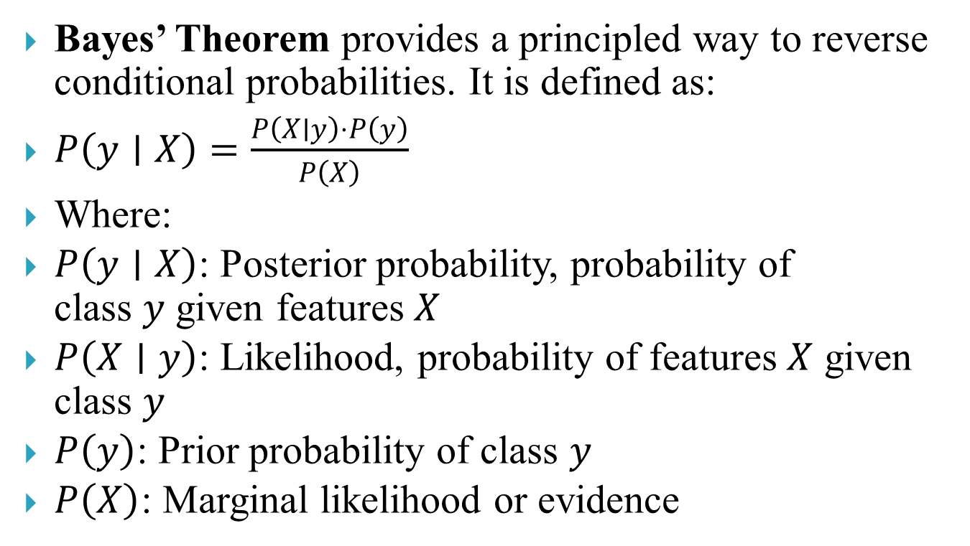
Bayes’ Theorem provides a principled way to reverse conditional probabilities. It is defined as:
$P\left(y∣X\right)=\frac{P\left(X∣y\right)⋅P\left(y\right)}{P\left(X\right)}$
Where:
$P\left(y∣X\right)$: Posterior probability, probability of class $y$ given features $X$
$P\left(X∣y\right)$: Likelihood, probability of features $X$ given class $y$
$P\left(y\right)$: Prior probability of class $y$
$P\left(X\right)$: Marginal likelihood or evidence

Slide 31
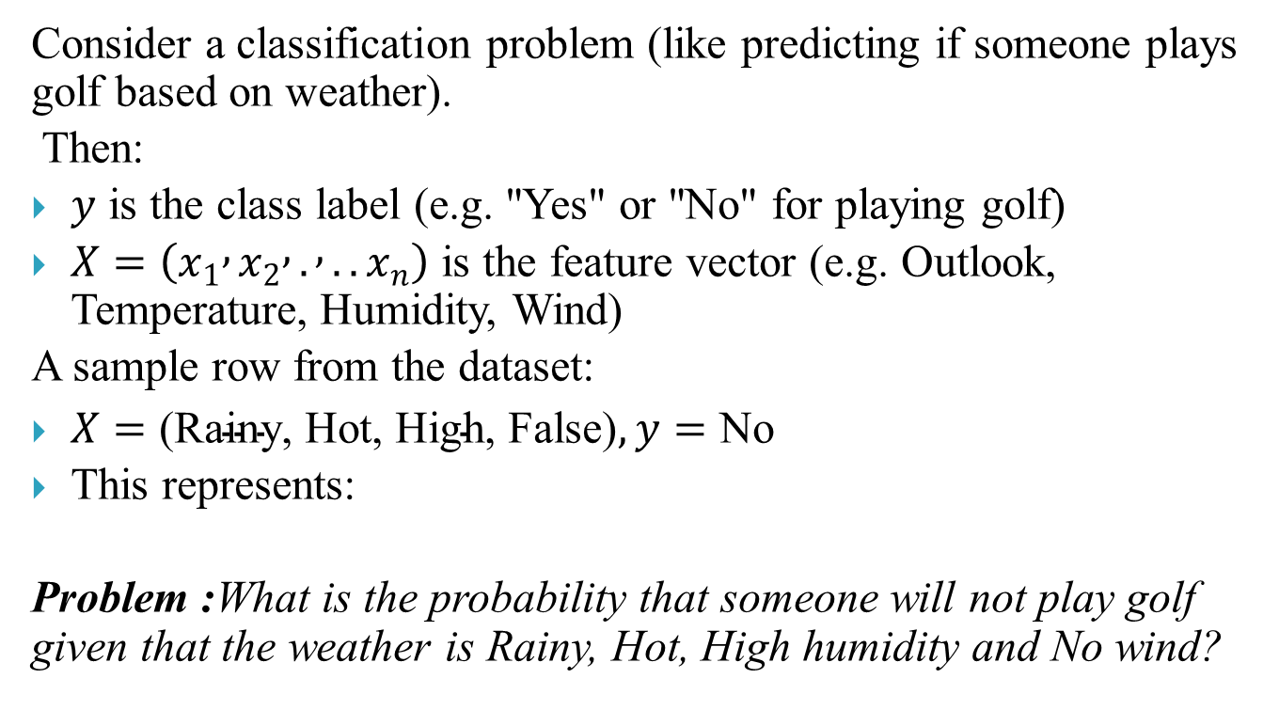
Consider a classification problem (like predicting if someone plays golf based on weather).
Then:
$y$ is the class label (e.g. "Yes" or "No" for playing golf)
$X=\left(x_{1} , x_{2} , . , ..x_{n}\right)$ is the feature vector (e.g. Outlook, Temperature, Humidity, Wind)
A sample row from the dataset:
$X=\text{(Rainy, Hot, High, False)}, y=\text{No}$
This represents:
Problem :What is the probability that someone will not play golf given that the weather is Rainy, Hot, High humidity and No wind?

Slide 32
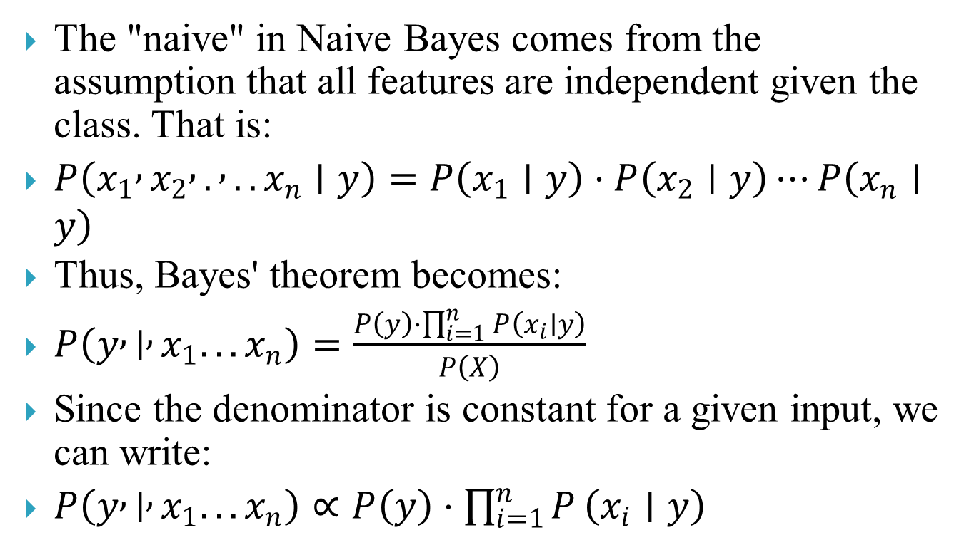
The "naive" in Naive Bayes comes from the assumption that all features are independent given the class. That is:
$P\left(x_{1} , x_{2} , . , ..x_{n}∣y\right)=P\left(x_{1}∣y\right)⋅P\left(x_{2}∣y\right)⋯P\left(x_{n}∣y\right)$
Thus, Bayes' theorem becomes:
$P\left(y , ∣ , x_{1}...x_{n}\right)=\frac{P\left(y\right)⋅\prod_{i=1}^{n}{P}\left(x_{i}∣y\right)}{P\left(X\right)}$
Since the denominator is constant for a given input, we can write:
$P\left(y , ∣ , x_{1}...x_{n}\right)∝P\left(y\right)⋅\prod_{i=1}^{n}{P}\left(x_{i}∣y\right)$

Slide 33
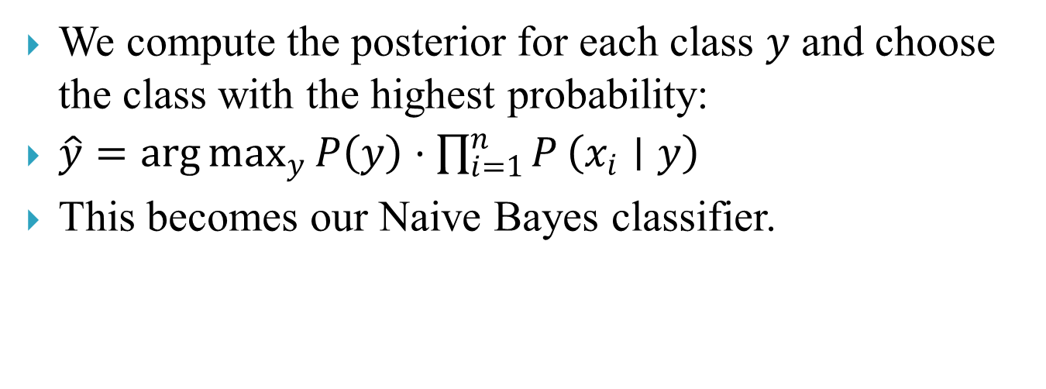
Constructing the Naive Bayes Classifier
We compute the posterior for each class $y$ and choose the class with the highest probability:
$\hat{y}=\arg{\max_{y}}P\left(y\right)⋅\prod_{i=1}^{n}{P}\left(x_{i}∣y\right)$
This becomes our Naive Bayes classifier.

Slide 34
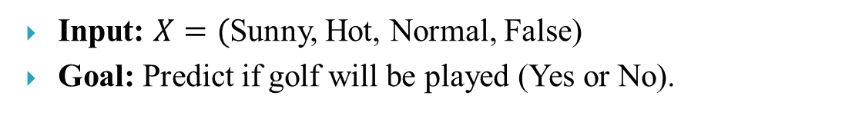
 | Outlook | Temperature | Humidity | Windy | Play Golf
0 | Rainy | Hot | High | False | Yes
1 | Rainy | Hot | High | True | No
2 | Overcast | Hot | High | False | Yes
3 | Sunny | Mild | High | False | No
4 | Sunny | Cool | Normal | False | Yes
5 | Sunny | Cool | Normal | True | No
6 | Overcast | Cool | Normal | True | Yes
7 | Rainy | Mild | High | False | No
8 | Rainy | Cool | Normal | False | Yes
9 | Sunny | Mild | Normal | False | Yes
10 | Rainy | Mild | Normal | True | Yes
11 | Overcast | Mild | High | True | Yes
12 | Overcast | Hot | Normal | False | Yes
13 | Sunny | Mild | High | True | No
Example: Weather Dataset
Let’s take a dataset used for predicting if golf is played based on:
Outlook: Sunny, Rainy, Overcast
Temperature: Hot, Mild, Cool
Humidity: High, Normal
Wind: True, False
Input: $X=($Sunny, Hot, Normal, False)
Goal: Predict if golf will be played (Yes or No).

Slide 35
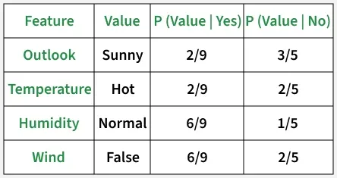
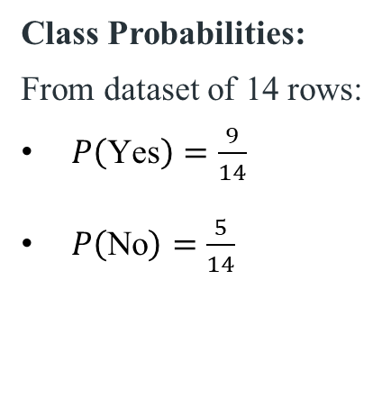
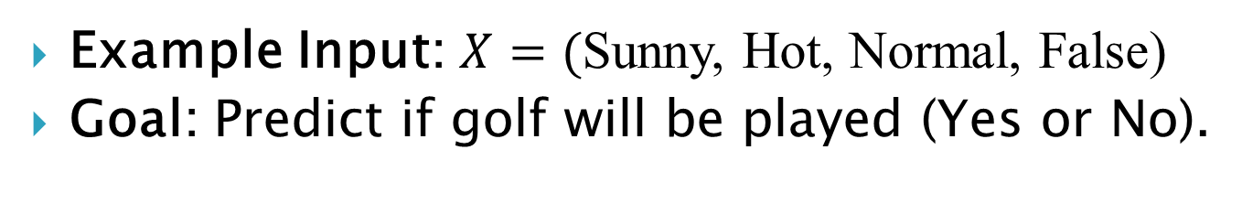
Example Input: $X=($Sunny, Hot, Normal, False)
Goal: Predict if golf will be played (Yes or No).
Class Probabilities:
From dataset of 14 rows:
$P\left(\text{Yes}\right)=\frac{9}{14}$
$P\left(\text{No}\right)=\frac{5}{14}$

Slide 36
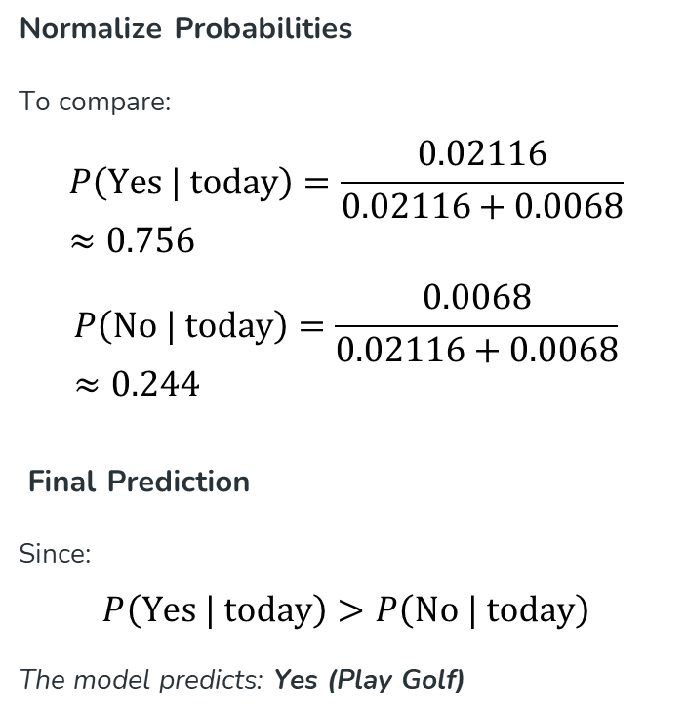
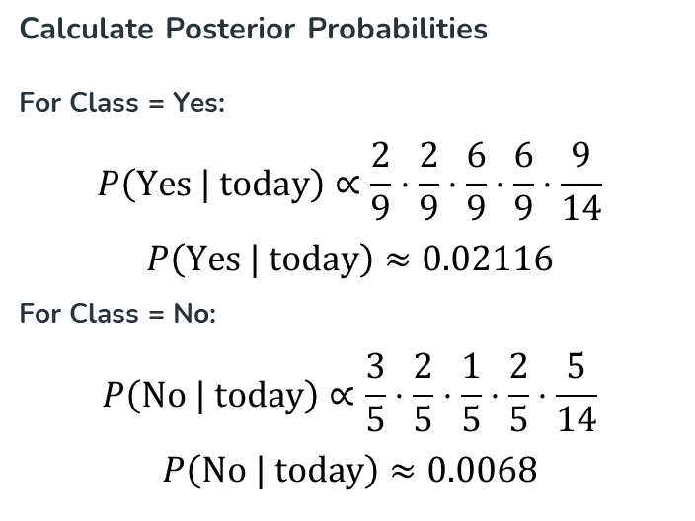
Calculate Posterior Probabilities
For Class = Yes:
$$P\left(\text{Yes | today}\right)∝\frac{2}{9}⋅\frac{2}{9}⋅\frac{6}{9}⋅\frac{6}{9}⋅\frac{9}{14}$$
$$P\left(\text{Yes | today}\right)≈0.02116$$
For Class = No:
$$P\left(\text{No | today}\right)∝\frac{3}{5}⋅\frac{2}{5}⋅\frac{1}{5}⋅\frac{2}{5}⋅\frac{5}{14}$$
$$P\left(\text{No | today}\right)≈0.0068$$
Normalize Probabilities
To compare:
$$P\left(\text{Yes | today}\right)=\frac{0.02116}{0.02116+0.0068}≈0.756$$
$$P\left(\text{No | today}\right)=\frac{0.0068}{0.02116+0.0068}≈0.244$$
Final Prediction
Since:
$$P\left(\text{Yes | today}\right)>P\left(\text{No | today}\right)$$
The model predicts: Yes (Play Golf)
https://www.geeksforgeeks.org/machine-learning/naive-bayes-classifiers/

Slide 37
Avoiding the Zero-Probability Problem
Naïve Bayesian prediction requires each conditional prob. be non-zero. Otherwise, the predicted prob. will be zero
Ex. Suppose a dataset with 1000 tuples, income=low (0), income= medium (990), and income = high (10)
Use Laplacian correction (or Laplacian estimator)
Adding 1 to each case
Prob(income = low) = 1/1003
Prob(income = medium) = 991/1003
Prob(income = high) = 11/1003
The “corrected” prob. estimates are close to their “uncorrected” counterparts

Slide 38
Naïve Bayes Classifier: Comments
Advantages
Easy to implement
Good results obtained in most of the cases
Disadvantages
Assumption: class conditional independence, therefore loss of accuracy
Practically, dependencies exist among variables
E.g., hospitals: patients: Profile: age, family history, etc.
Symptoms: fever, cough etc., Disease: lung cancer, diabetes, etc.
Dependencies among these cannot be modeled by Naïve Bayes Classifier
How to deal with these dependencies? Bayesian Belief Networks (Chapter 9)

Slide 39
THANK YOU

